Slide 1
R(T) correction WO3196 Device 9
Rijk Hogenbirk
17/04/2020

Slide 2
Measurements
Hydrogen to Air measurement
0324_1904_WO3196dev9_H2ToAir
R(T) fit
0327_1231_WO3196dev9_Tsteps5C_RvsT

Slide 3
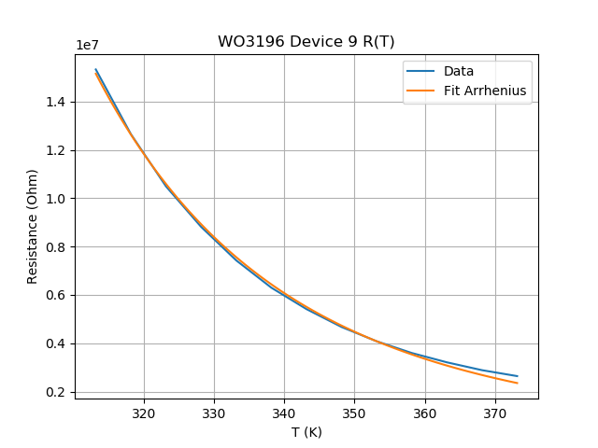
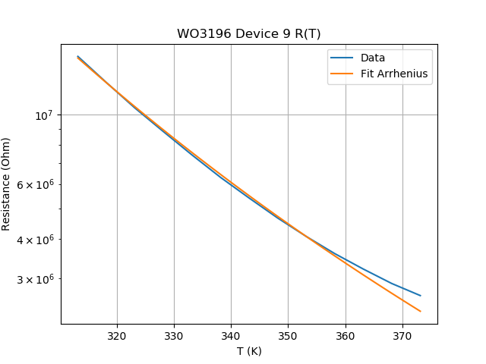

Dev9 40-100C R(T) fits –only R(T)
0327_1231_WO3196dev9_Tsteps5C_RvsT
$$R=A e^{\frac{E_{a}}{k_{b}T}}$$
Variable | Value | Std | Unit
A | 1.42E+02 | 1.94E+01 | Ohm
Ea | 312 | 3.82 | meV
Fit looks good and Ea is in the same range as the value from Giordano

Slide 4
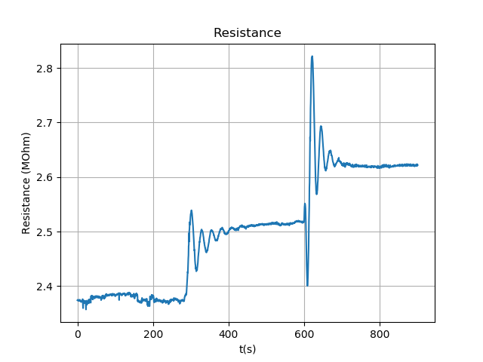
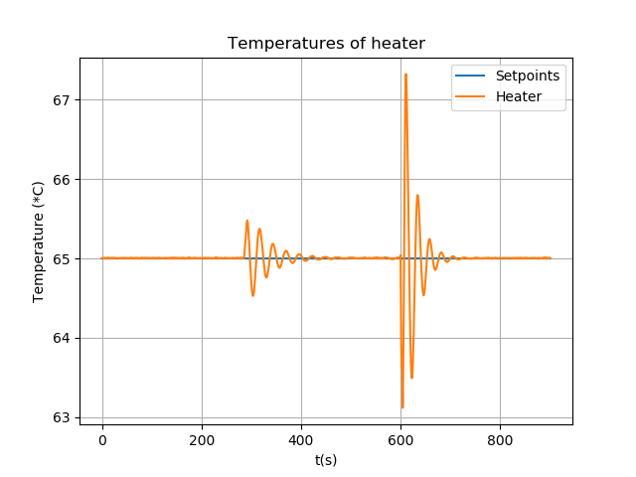
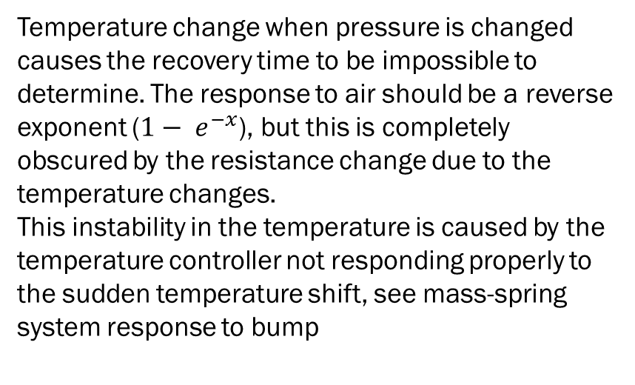
H2toAir measurement
0324_1904_WO3196dev9_H2ToAir
Temperature change when pressure is changed causes the recovery time to be impossible to determine. The response to air should be a reverse exponent ($1− e^{−x}$), but this is completely obscured by the resistance change due to the temperature changes.
This instability in the temperature is caused by the temperature controller not responding properly to the sudden temperature shift, see mass-spring system response to bump

Slide 5
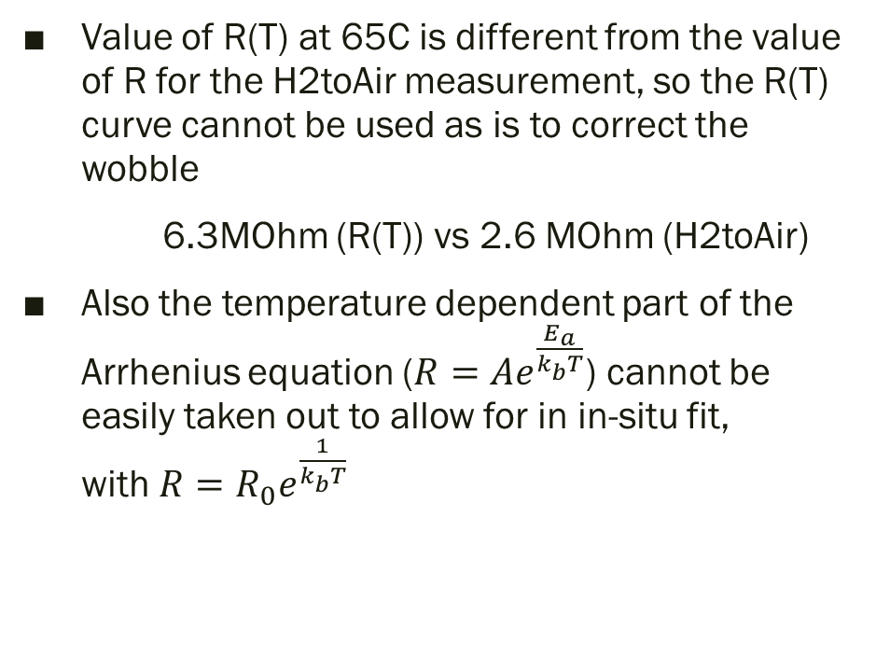
Problem
Value of R(T) at 65C is different from the value of R for the H2toAir measurement, so the R(T) curve cannot be used as is to correct the wobble
6.3MOhm (R(T)) vs 2.6 MOhm (H2toAir)
Also the temperature dependent part of the Arrhenius equation ($R=Ae^{\frac{E_{a}}{k_{b}T}}$) cannot be easily taken out to allow for in in-situ fit, with $R=R_{0}e^{\frac{1}{k_{b}T}}$

Slide 6
Plan to correct temperature wobble H2toAir measurement
Assume temperature dependence will be the same across measurements, i.e. Ea is constant
Use the free A parameter to adjust Arrhenius equation to the correct resistance range for each point of the H2toAir measurement
Use the Arrhenius equation to artificially correct the temperature to 65C that the device should have the entire measurement

Slide 7
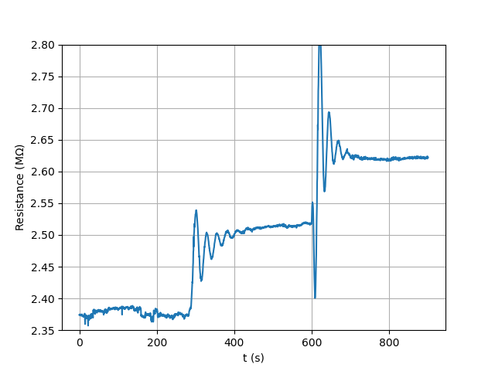
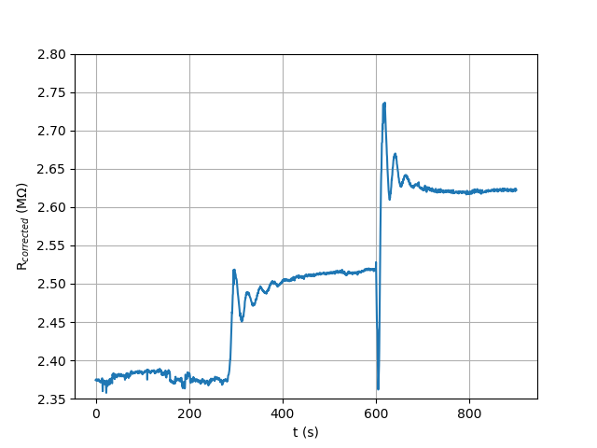
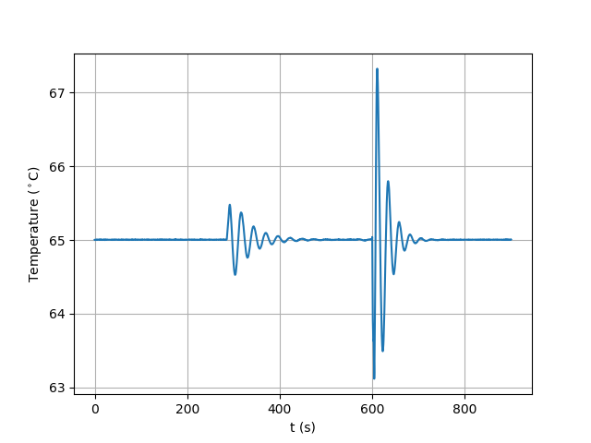
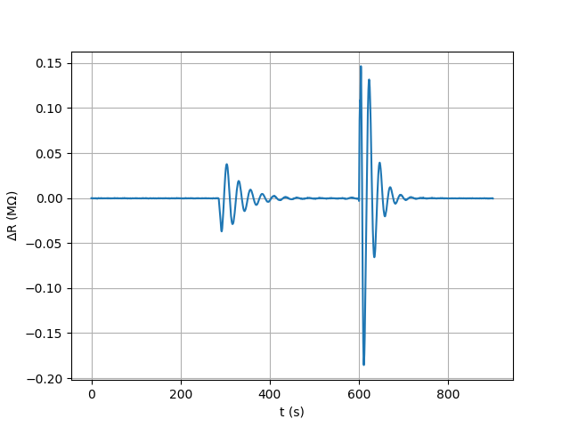
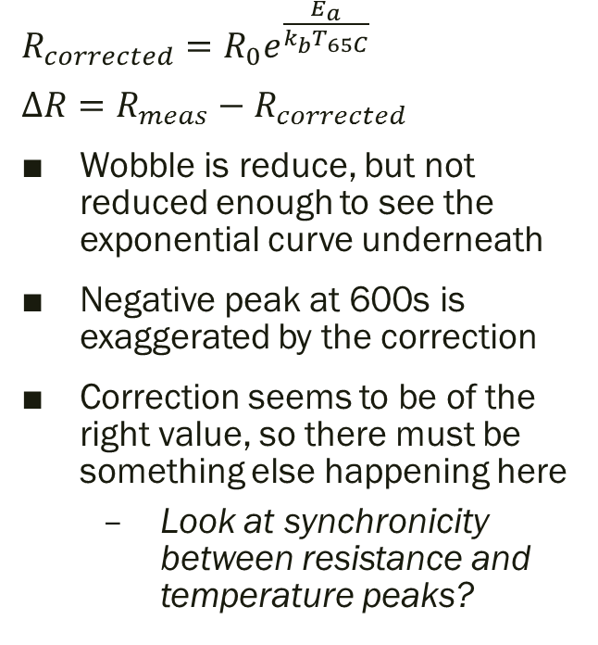
Correction (1)
$R_{corrected}=R_{0}e^{\frac{E_{a}}{k_{b}T_{65C}}}$
$ΔR=R_{meas}−R_{corrected}$
Wobble is reduce, but not reduced enough to see the exponential curve underneath
Negative peak at 600s is exaggerated by the correction
Correction seems to be of the right value, so there must be something else happening here
Look at synchronicity between resistance and temperature peaks?

Slide 8
Synchronicity
Check time of first negative temperature peak and first negative resistance peak
Negative peak as resistance is positively correlated with temperature
If there is an offset between the two, implement this in the correction

Slide 9
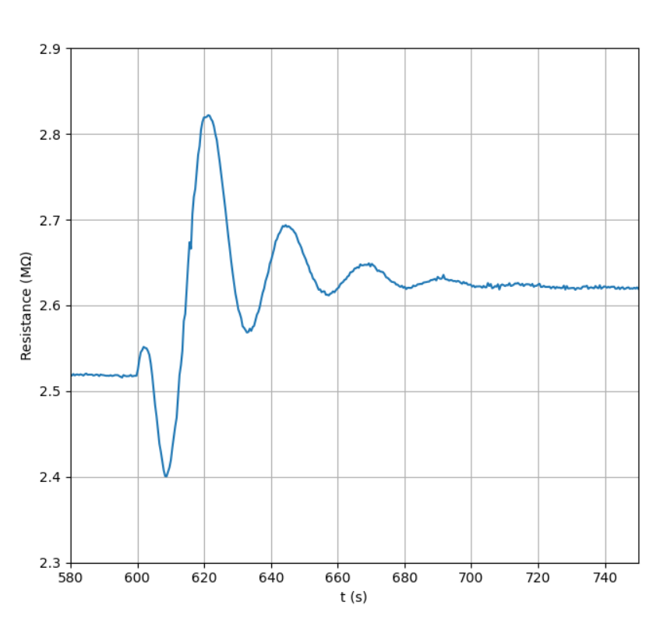
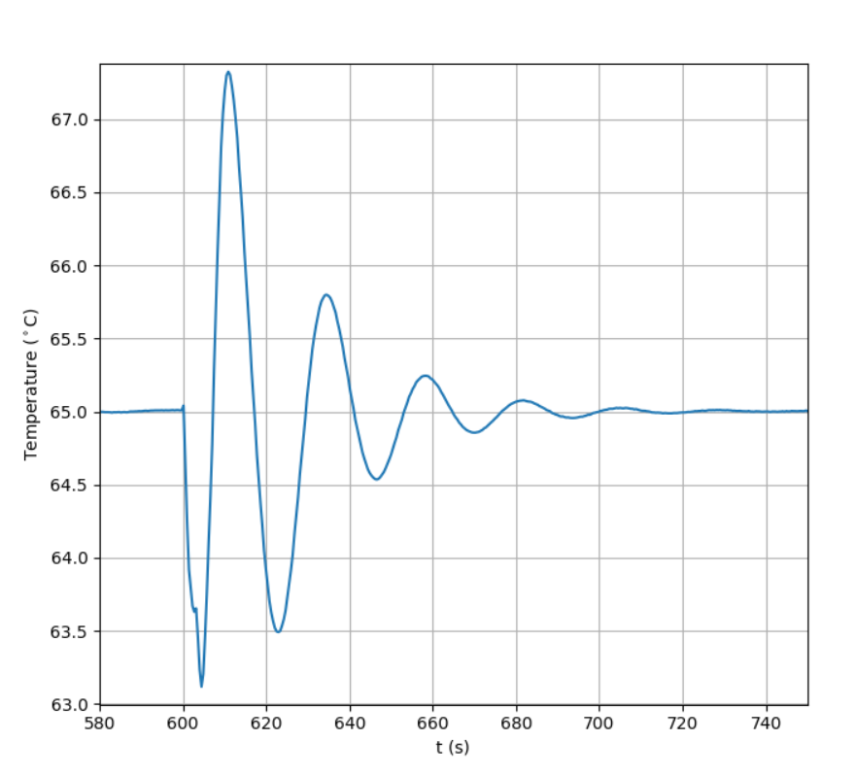
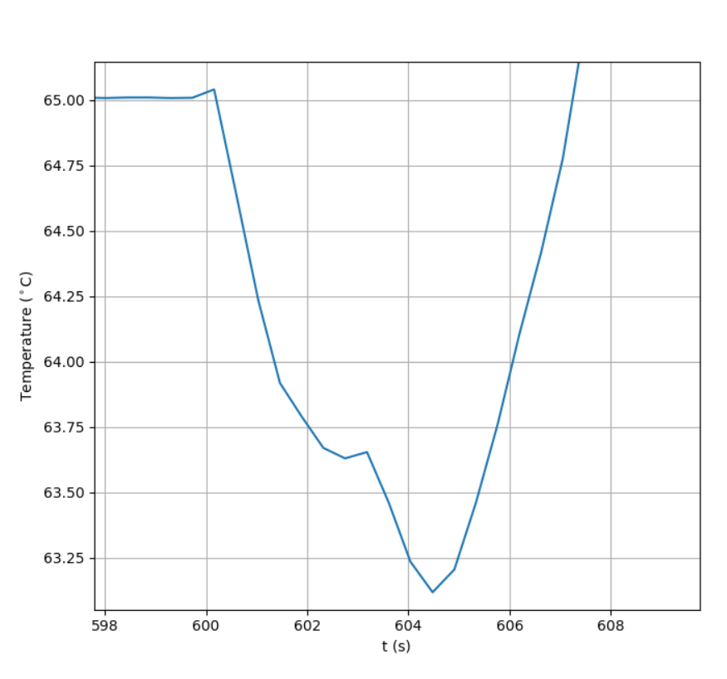
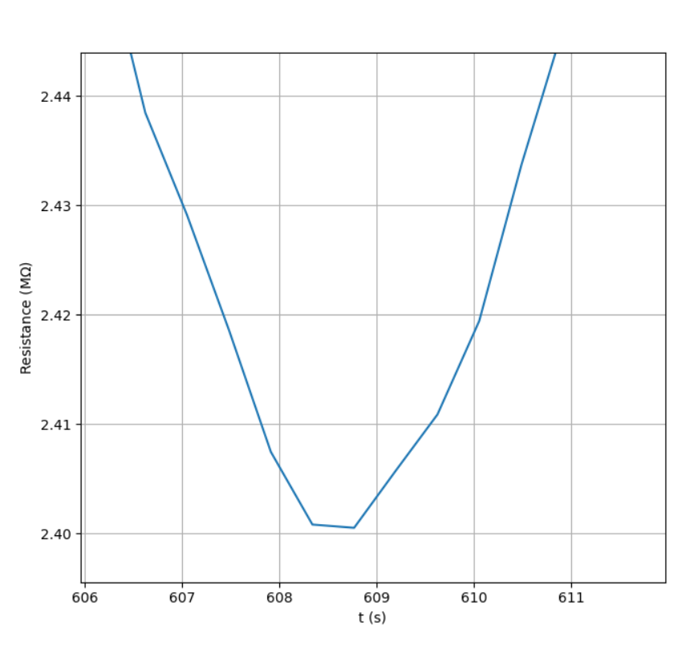
Synchronicity first peak
Double peak with the second one more pronounced
First at 602.75 s
Second at 604.5 s
First negative peak at 608.5 s
So there is a time shift between the peaks of at least 4 seconds

Slide 10
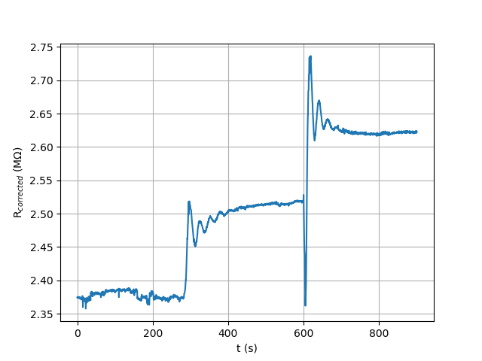
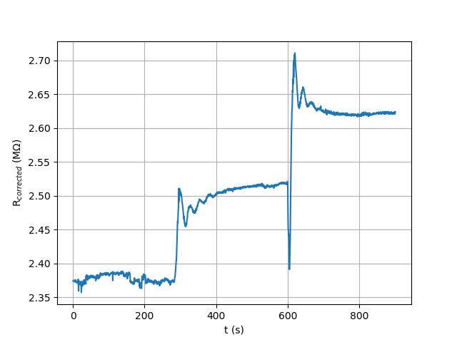
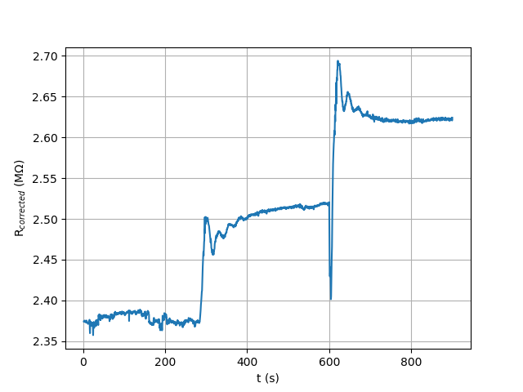
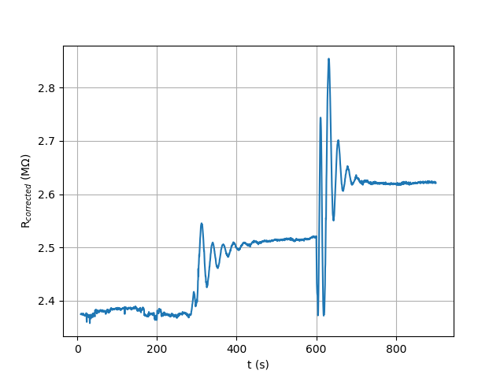
Correction with time shift
Dt = 0 steps, 0 s
Dt = 2 steps, 0.86 s
Timeshift can only be multiples of the time between measurements
Measurement time (or step) is 0.43 s
Peaks are the smallest for a time shift of 4 steps, but do not disappear enough to show the exponential curve
If the time shift is increase further, the correction overshoots the peaks and creates more and deeper peaks
Note: different y-scale for all images
Dt = 4 steps, 1.72 s
Dt = 20 steps, 8.6 s

Slide 11
FFT Correction
As the temperature wobble is periodic, one should be able to filter it out in Fourier space
To do this, first the FT spectra of the temperature and resistance measurements need to be taken to see which contributions come from the temperature wobble and which from the response to changes in hydrogen
Then some filter needs to be applied to filter out the contributions from the temperature wobble

Slide 12
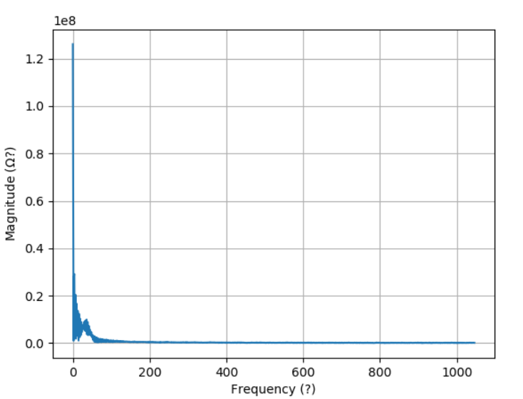
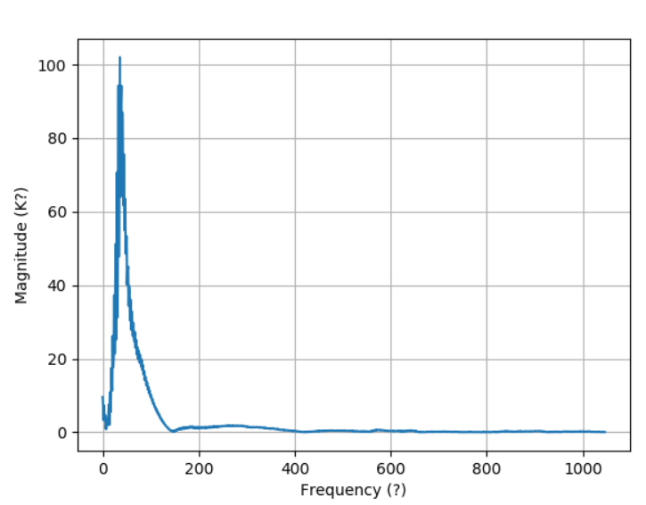
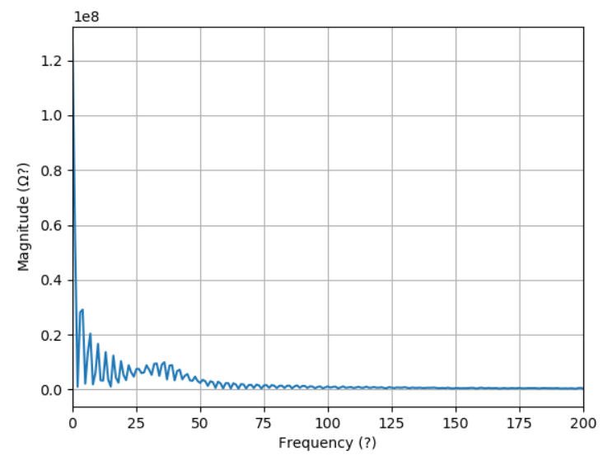
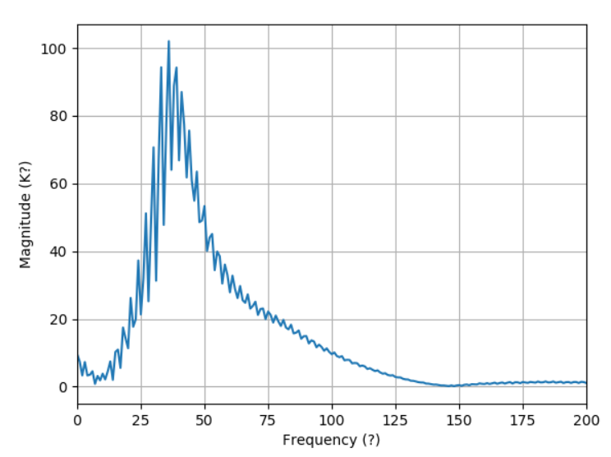
FFT Results
Resistance
Temperature
Around 50 (Units?) there is a peak in the temperature spectrum and also a slight one in the resistance spectrum
Other contribution to the resistance spectrum is the step function-exponential from the response to air/hydrogen
In the resistance spectrum below 25 there is also some stuff, so this might be the underlying data and the peak around 50 the contribution of the temperature wobble
So a bandpass filter around 50 might filter out the wobble
Magnitude in this slide means absolute value of the FT, frequency here is the index of the array, not Hz

Slide 13
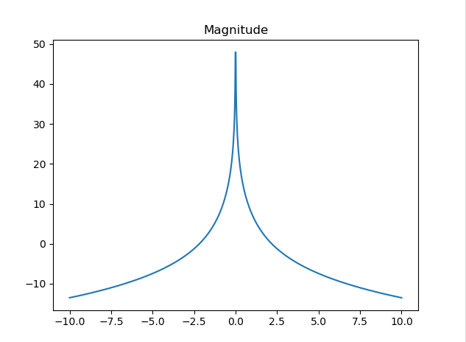
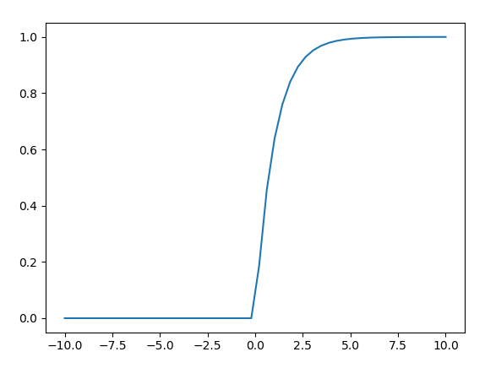
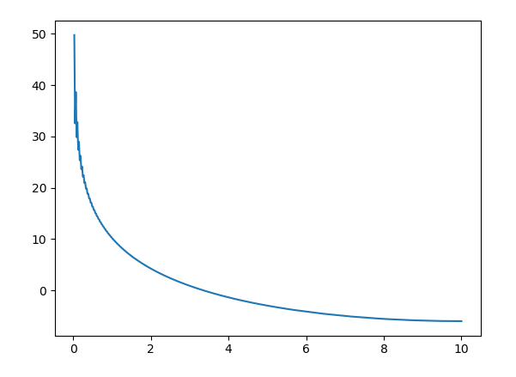
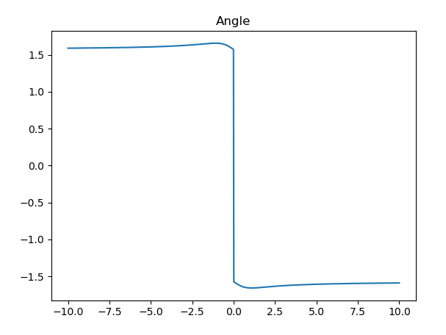

FT of response to air
Fourier space
$F\left(\left(1−e^{−x}\right)u\left(x\right)\right)=\sqrt{\frac{2}{π}}\left(\frac{1}{iπω}−\frac{1}{π\left(a+iω\right)}\right)$ for $ω≠0$
As $F\left(u\left(x\right)\right)=\frac{1}{\sqrt{2π}(a+iω)}$
Real time
Python FFT

Slide 14
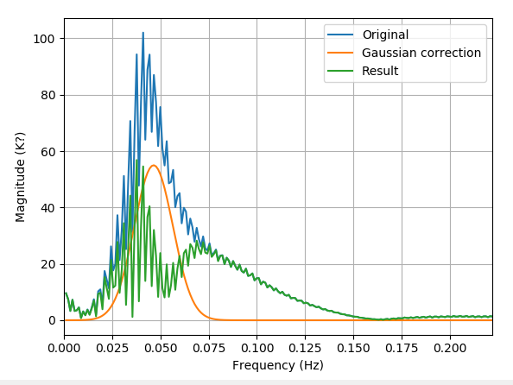
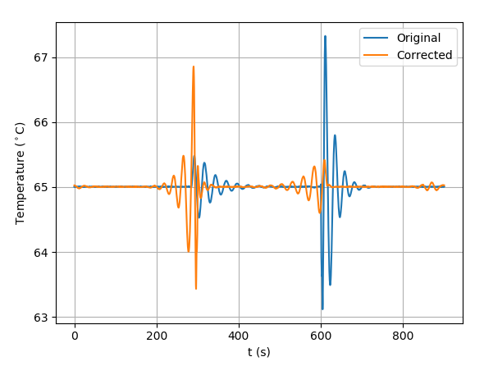
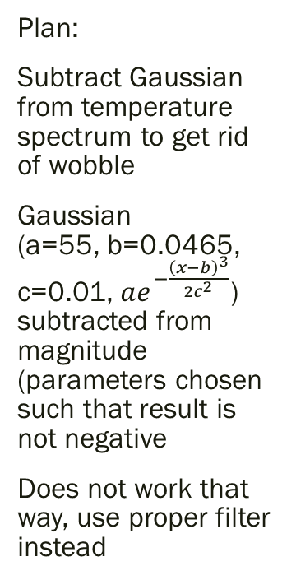
FFT Correction – Subtract Gaussian
Plan:
Subtract Gaussian from temperature spectrum to get rid of wobble
Gaussian (a=55, b=0.0465, c=0.01, $ae^{−\frac{{\left(x−b\right)}^{3}}{2c^{2}}}$) subtracted from magnitude (parameters chosen such that result is not negative
Does not work that way, use proper filter instead

Slide 15
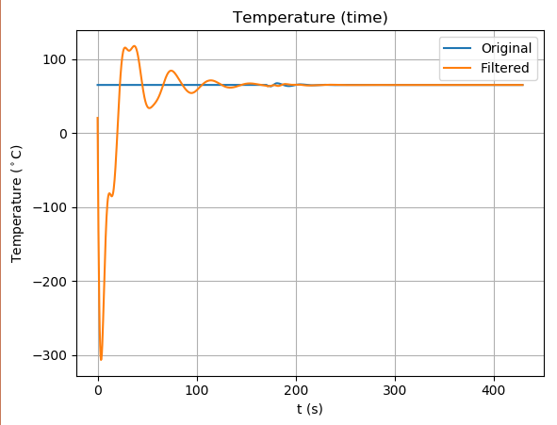
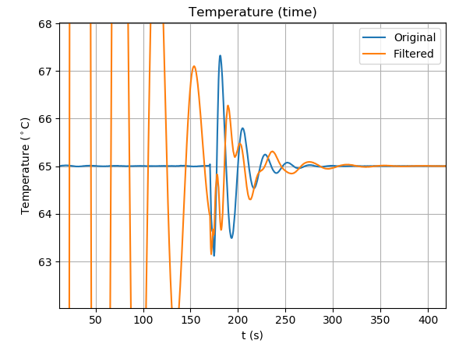
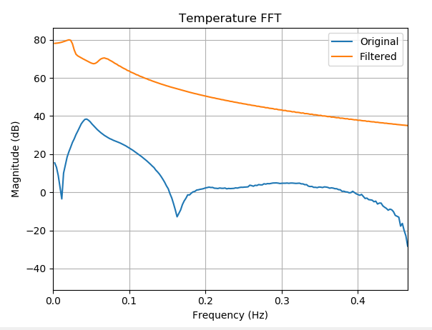
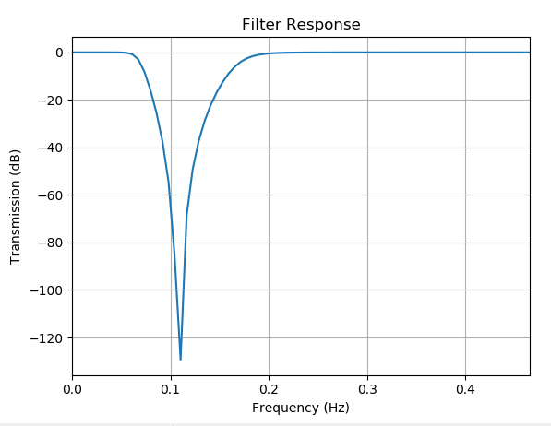
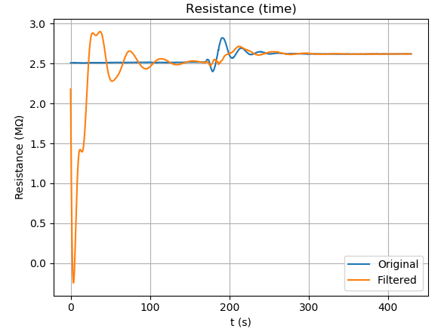
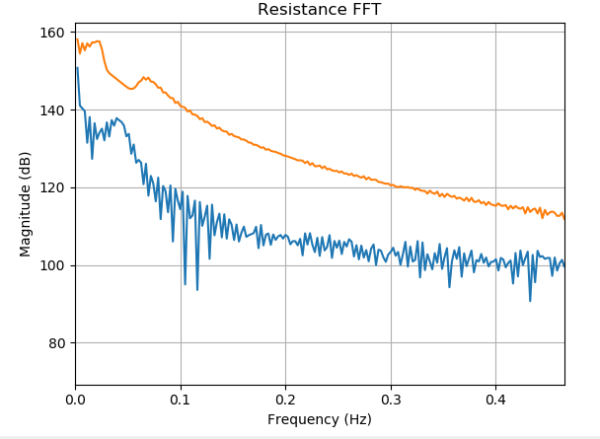
FFT – Actual Filter (bandstop)
Filtering causes weird behaviour in the first part of the measurements
Bandstop filter between 25 and 65 mHz
4th order Butterworth (scipy.signal.butter)
Filter dip is off from the centre frequency of the peak in the temperature spectrum

Slide 16
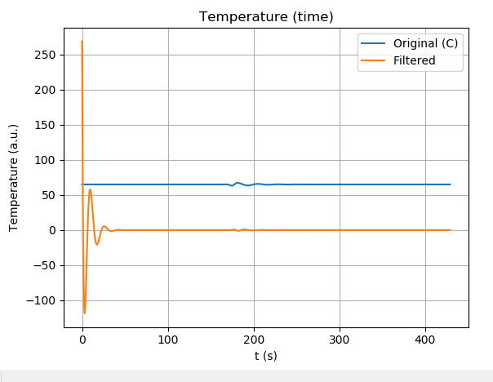
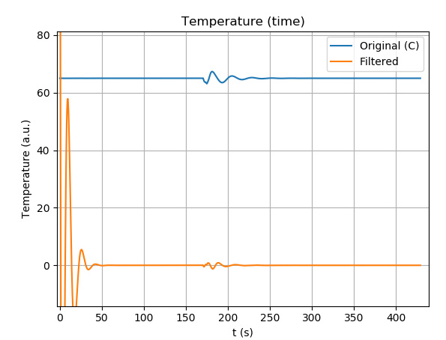
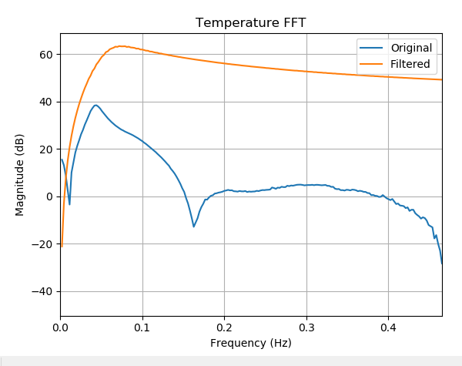
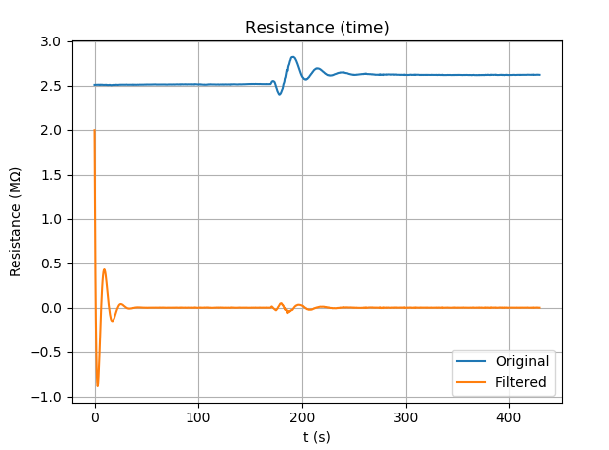
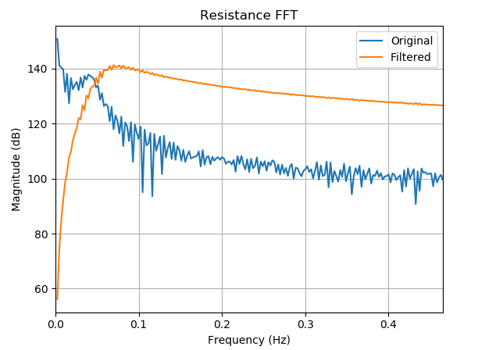
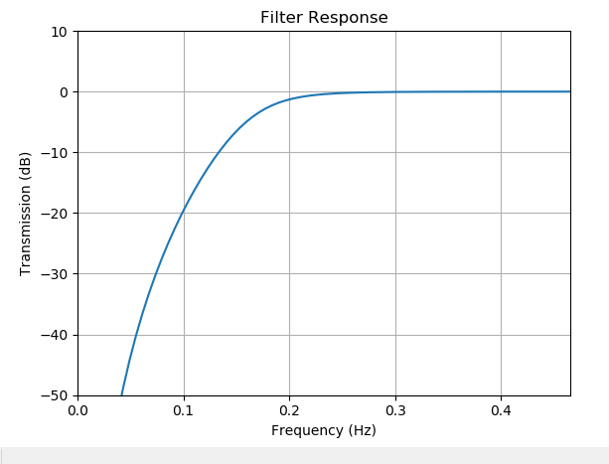
FFT – Actual Filter (high pass)
High pass filter of the 4th order with f=0.065Hz
High pass filter gets rid of the change in resistance as well as the constant component
This makes it impossible to get out the response time

Slide 17
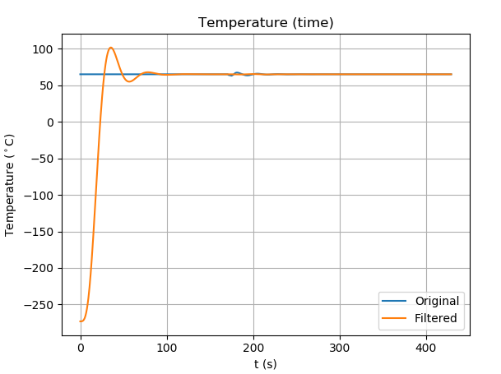
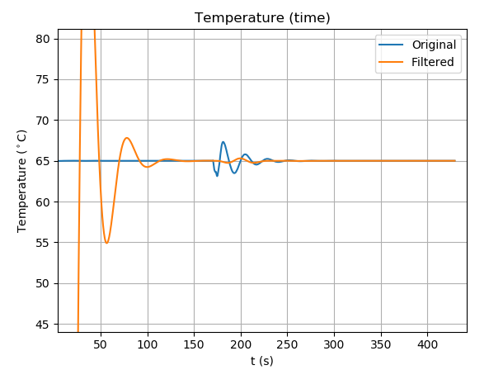
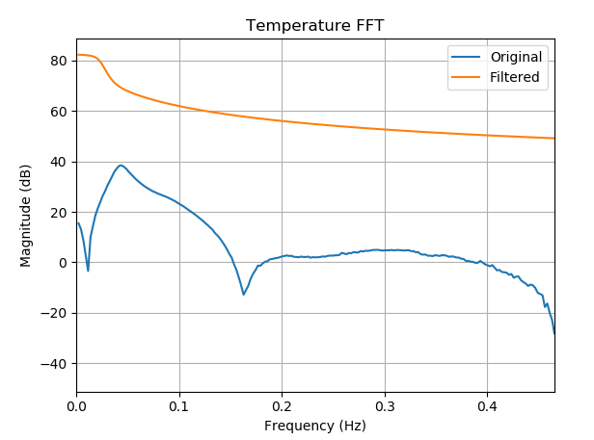
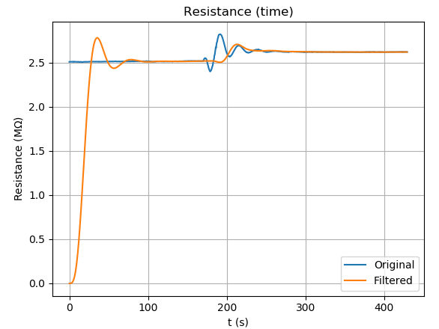
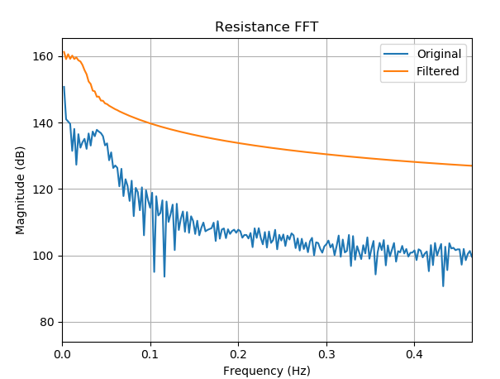
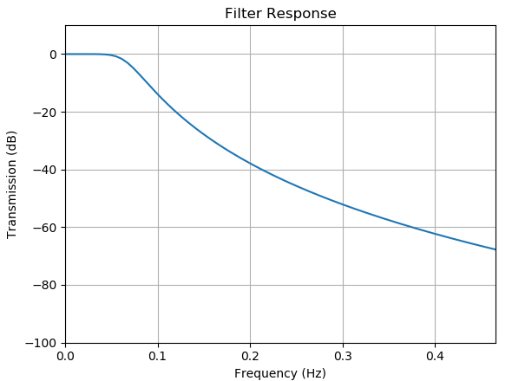
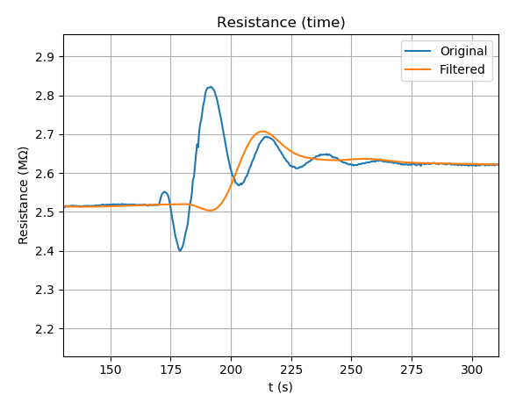
FFT – Actual Filter (lowpass)
Lowpass Butterworth filter of the 4th order with cutoff frequency at 0.025 Hz
Leaves step intact, but significantly slows down the response as it takes out high-f terms

Slide 18
End

Slide 19



$R_{0}$ and $ΔR$ calculation
$R_{0}=R_{meas}e^{−\frac{E_{a}}{k_{b}T_{meas}}}$
Ranges from 53 to 62 Ohm, which is smaller than the A from the Arrhenius fit, but in the same order of magnitude

Slide 20


Correction (2)
Here, the first wobble is zoomed in on, between 280 and 420s
The correction has a peak before the wobble ha

